Slide 1
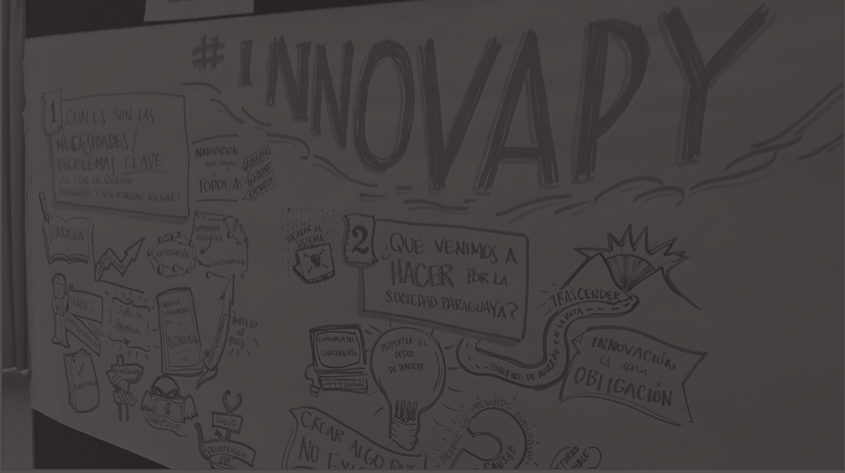
NATIONAL INNOVATION STRATEGY
PARAGUAY
ACADEMIA - PRIVATE SECTOR - CIVIL SOCIETY - GOVERNMENT

Slide 2
Paraguay
Asunción

Slide 3
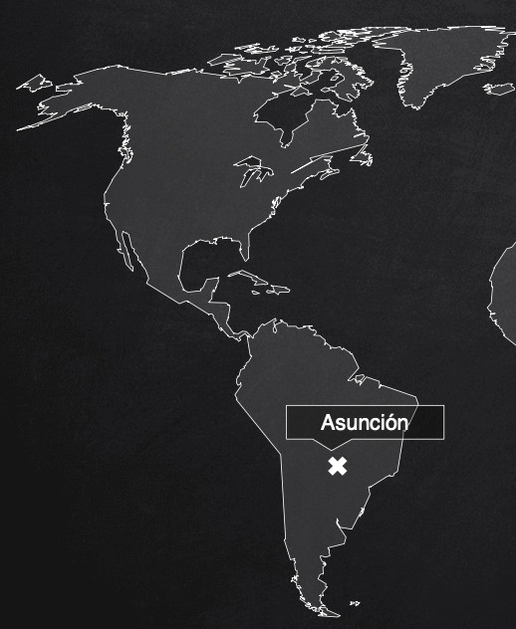
Paraguay
Population: ~6,950,000 (2018)
GDP: ~$40.5 Billion USD (2018)
Top 5 Exports:
Soybeans ($2.2 B)
Soymeal ($741 M)
Frozen Beef ($577 M)
Beef ($577 M)
Soybean Oil ($482 M)
Source: World Bank, OEC

Slide 4



THE GDP OF PARAGUAY IS EQUIVALENT TO...
10%
OF FACEBOOK’S VALUATION
7%
OF GOOGLE’S VALUATION
5%
OF APPLE’S VALUATION

Slide 5
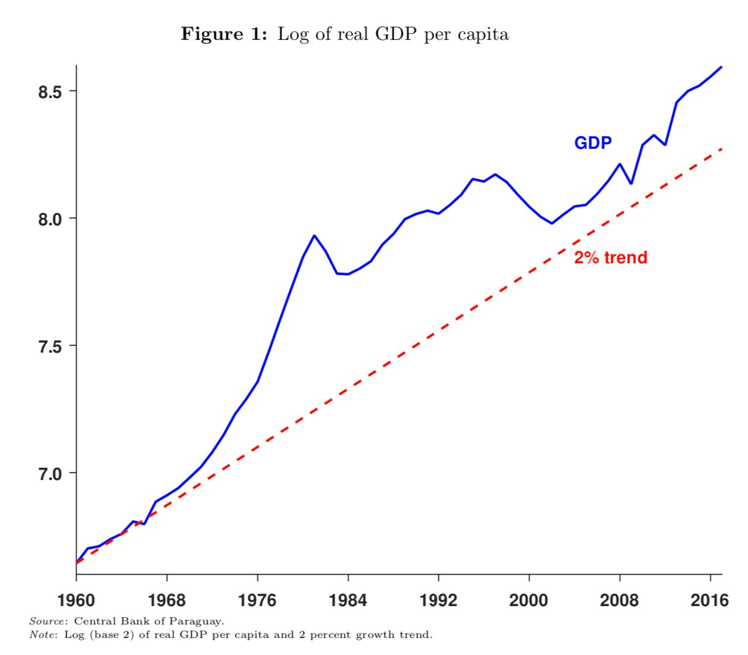

Strong
Economic Performance

Slide 6
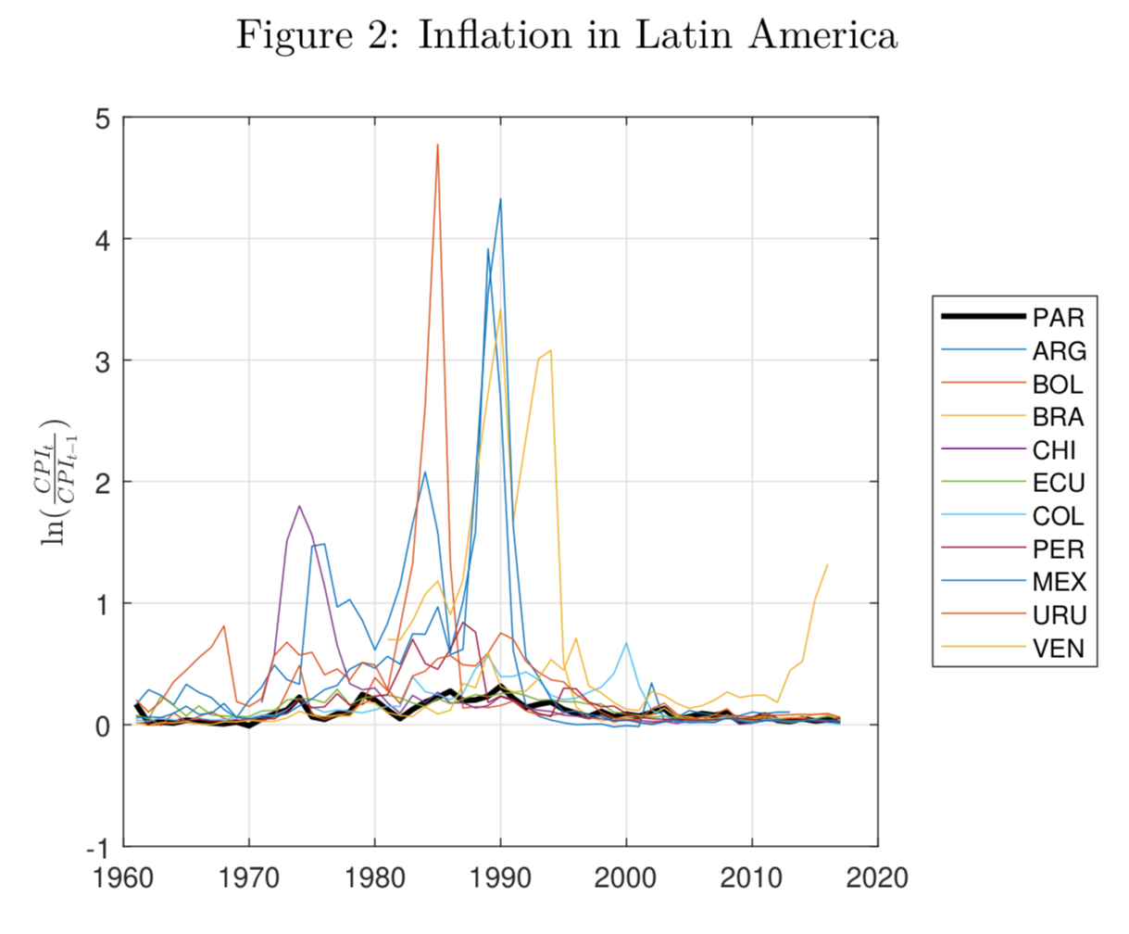

Monetary Stability for more than
75 years

Slide 7
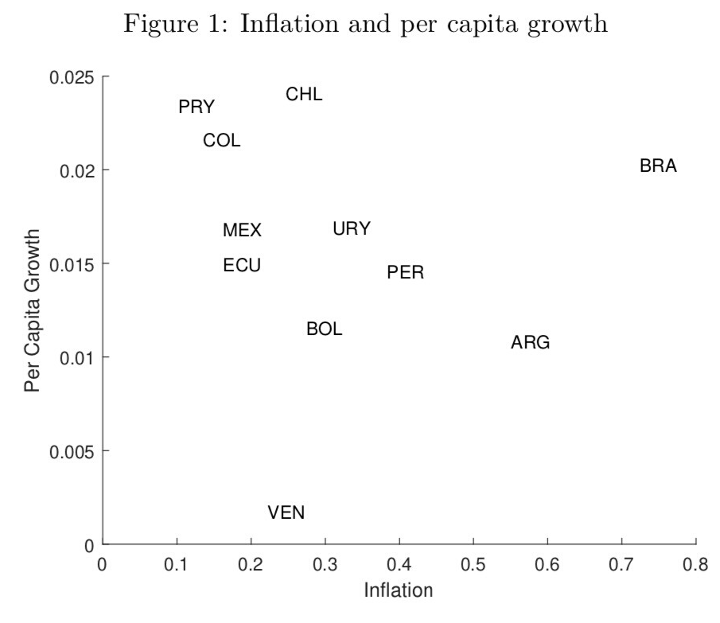
Remarkable Inflation Performance - GDP

Slide 8

THIS IS NECESSARY, BUT NOT SUFFICIENT FOR
inclusive and exponential growth

Slide 9

In the next 10 years, we will see the most revolutionary inventions that man has produced since the invention of the wheel (3500 BC)
Andrés Oppeinheimer "Crear o Morir" (2014)

Slide 10

SCIENTIFIC ADVANCES HAVE NOT ONLY CHANGED OUR LIVES, BUT THEY ALSO DETERMINE WHICH COUNTRIES PROGRESS AND WHICH ARE LEFT BEHIND

Slide 11
WITH A 4.2% GROWTH RATE PARAGUAY WILL NEED...
20 YEARS
IN ORDER TO CONVERT ITSELF INTO A HIGH-INCOME COUNTRY
Source: Rule of 70 using World Bank definition for high-income economies (GDP/Capita of US$ 12,055) and Paraguay's GDP/Capita of US$ 5,650 (2018).

Slide 12


How can Paraguay continue to position itself in the technological value chain and utilize innovation?

Slide 13
NATIONAL INNOVATION STRATEGY
ACADEMIA - PRIVATE SECTOR - CIVIL SOCIETY - GOVERNMENT

Slide 14
WHAT DO WE WANT TO ACHIEVE?
To use innovation to accelerate inclusive and sustainable development in Paraguay

Slide 15
To Innovate is to convert knowledge and creativity into improved well-being, financial resources, and a better future for citizens

Slide 16
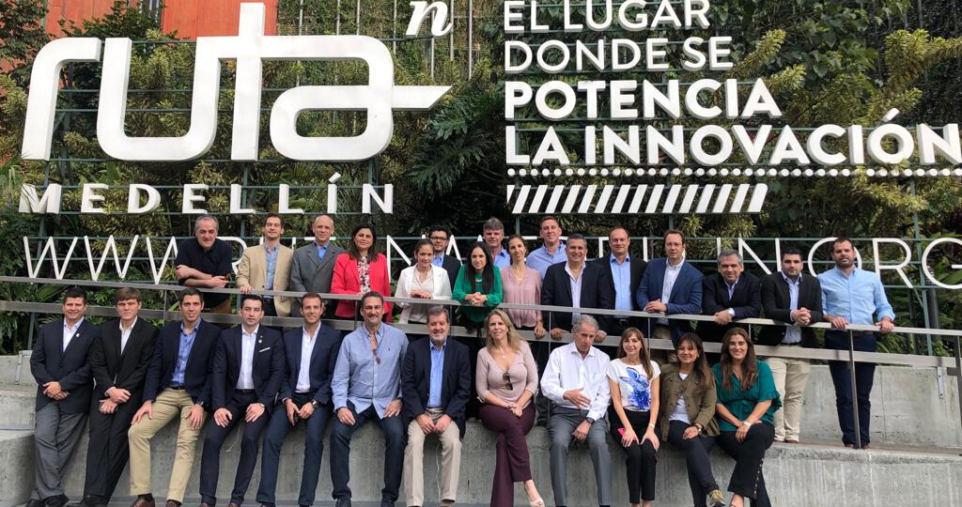
Trip to Medellín - Colombia
(Nov 18)

Slide 17
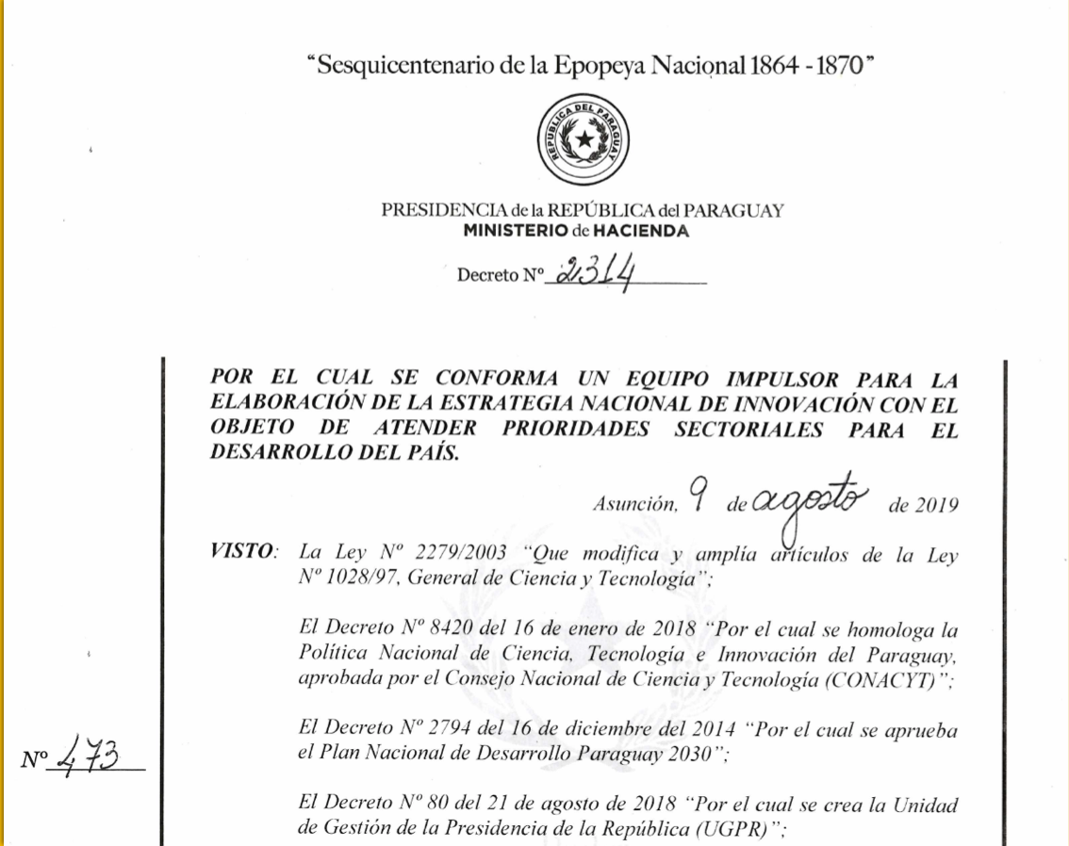
Government Response - National Decree
August - 19

Slide 18



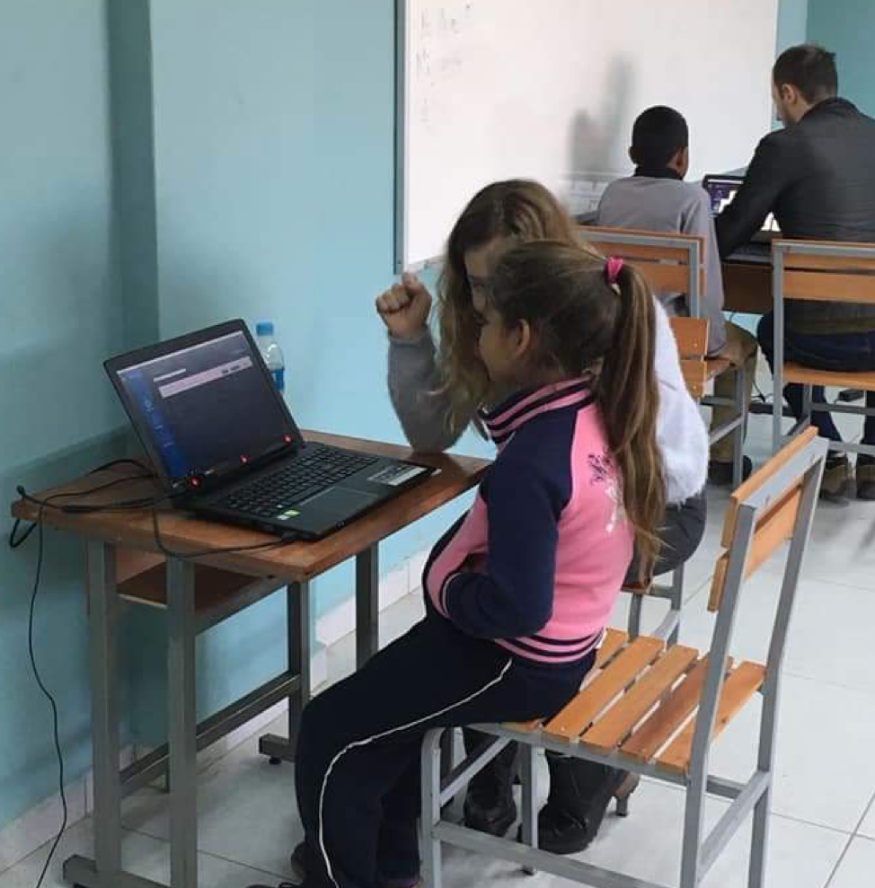
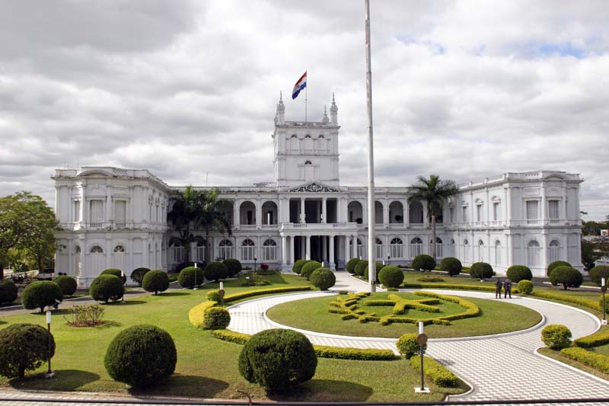

MULTI-SECTOR OVERSIGHT
INNOVATION
SOCIAL
PRIVATE SECTOR
PUBLIC SECTOR

Slide 19
Driving Team
Private Sector
Presidential Delivery Unit
Treasury
Industry & Commerce
Ministry of Work, Jobs, & Social Security
National Innovation Strategy
Academia & Scientific Community
Public Sector
Secretariat of Economic Development
Council on Science & Technology
Ministry of Information, Technology, & Information
Civil Society

Slide 20
Selection Process for Driving Team
173
45
18
Applicants
Interviewed
Selected
Evaluated profiles to ensure candidates fit prerequisites
Individuals invited for an evaluative interview
Selected for the Driving Team

Slide 21
COMMUNITY
Operative Team: organizes and oversees strategy execution
Collaborators: assists with the identification of challenges
Driving Team: test and validate national challenges and the creation of the new governance unit
Advisors (National and International): advisors to help with the identification and selection of national challenges and their initiatives

Slide 22


International advisory, consultation, and validation
Governance Unit
DRIVING TEAM
Initiatives to Address Challenge
Qualitative Data
Grounded theory
Innovation Documents
Generation of Challenges
Supporting Institutions:
Identification of Consensus
(Delph Principle)
Reasearch and Action
Notes:
Asesoría Internacional,
espacios de consultas y validaciót

Slide 23


CHALLENGE 1
Specific challenges
CHALLENGE 2
Specific challenges
CHALLENGE 3
Specific challenges
CHALLENGES
CHALLENGE 4
Specific challenges
CHALLENGE 5
Specific challenges
CHALLENGE n
Specific challenges

Slide 24
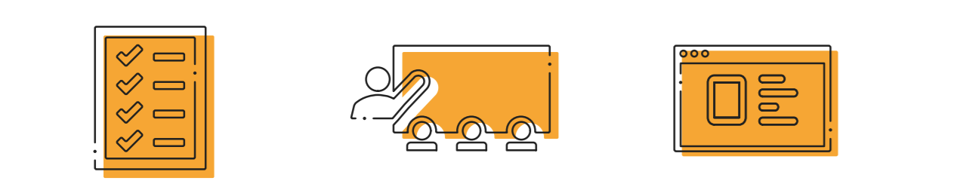
Mechanisms of Participation
Online Form
In-Person Workshop
Online Workshops
Online in the country and abroad
Throughout the country
Available 24/7

Slide 25


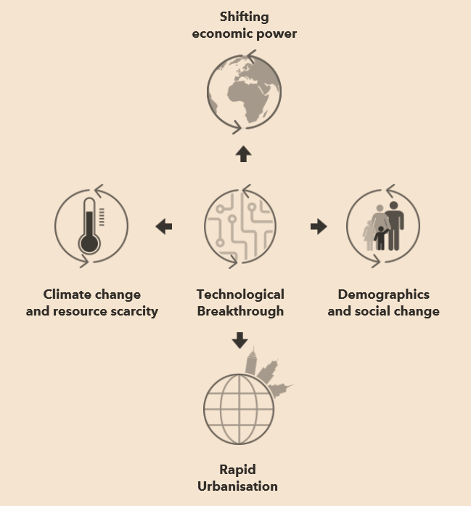
CHALLENGES
P1
THEMATIC TRENDS
DAILY CHALLENGES
MEGA-TRENDS
NEW TECHNOLOGIES
SOCIAL TECHNOLOGIES
SPECIALISTS
S1
INNOVATION & DEVELOPMENT CENTERS
CREATING THINKERS
INNOVATIVE COMPANIES
MODELS
CAPACITIES OR SOLUTIONS

Slide 26
Progress Thus Far
13
228
In-Person Workshops
Unique Participants

Slide 27
Progress Thus Far
+300
6
Identified Opportunities to Innovate
Emerging Challenges

Slide 28
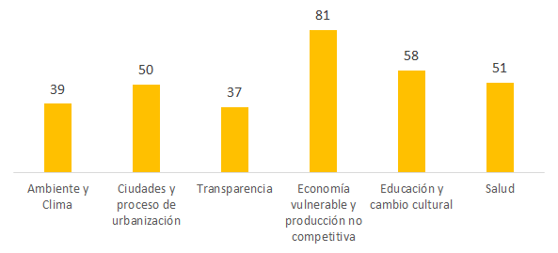
Environment & Climate
Citizens & Urbanization
Transparency
Undiversified & Uncompetitive Economy
Education & Cultural Change
Health

Slide 29
Next Steps
2019
2020
Daily Problems
December
February
April
May
Launch
Start Road Map
Document Analysis
Identification of Problems
Governance Proposal
Historic & Scientific Validation
Mega-Trends
Prioritization:
Visibility
Transversability
Value generation
Notes:
Visión un poco más macro

Slide 30

We look at the world as an opportunity...

Slide 31

Innovation, research, and technology can be our greatest allies

Slide 32

TECHNOLOGICAL ADVANCEMENT IS INEVITABLE...
WE INNOVATE,
OR WE GET LEFT BEHIND

Slide 33

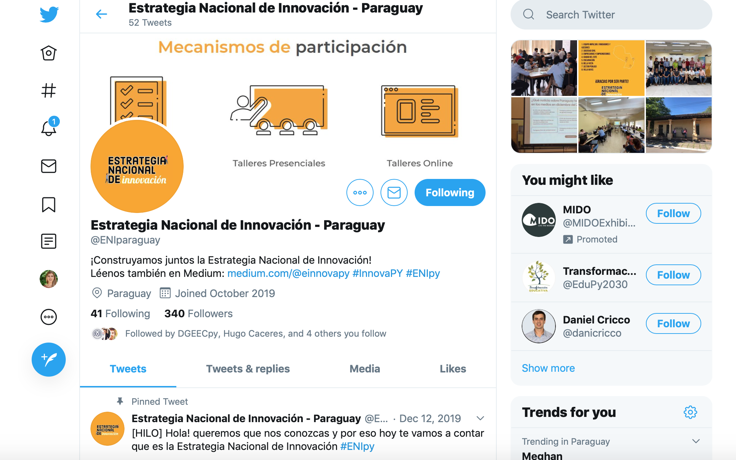
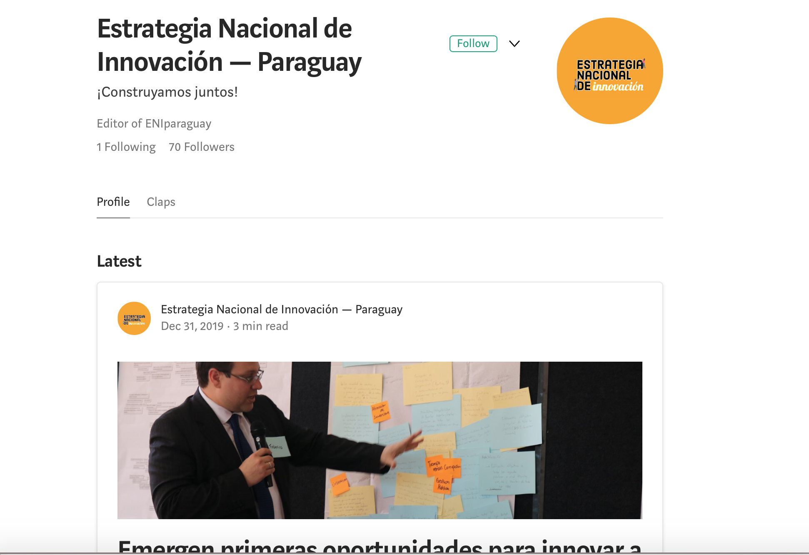
Facebook
@ENIparagauy
Twitter
@ENIparagauy
Medium
@einnovapy

Slide 34


